Slide 1
Theatre Bookings Operational Research
Updated September 2019
Notes:
The aims of this workshop are:
-To explore bin packing algorithms, including where they are used in the real world.
-To understand how maths and operational research are used in real life.

Slide 2
Introduction
You are in charge of the seating arrangements for the audience of an upcoming theatre show.
Your need to find the best way to organise the audience group bookings, so that when they are seated they take up the least amount of space possible.
Notes:
The students work at a local theatre and have been put in charge of the seating arrangements. They must find the best way to organise the audience members that have already booked online or over the phone, so that they take up the least amount of space possible.
(Student worksheet question 1) Encourage students to discuss why the audience members should be organised in such a way that minimises the amount of space used
Answer: so that there is more space for people who buy tickets on the door, in order to sell more tickets/maximise profit, audience members feel more comfortable sat together rather than sat on their own in different places around the theatre etc.
Ask the students if they can think of an experience they have had which involves this type of idea
Possible answers: Ticketmaster automatically allocates seats, some cinemas allow people to choose where they sit, some sports events in stadiums etc.
(Student worksheet question 2) What is the problem with this?
Answer: People often leave small gaps between groups, choosing to sit on the outside of a row and leaving gaps in the middle that are difficult to fill/see

Slide 3
Theatre Information
Stage
1 | 2 | 3 | 4 | 5 | 6 | 7 | 8 | 9 | 10
2
3
4
5
6
7
8
9
10
11
12
The audience seating area in the theatre is arranged such that there are 12 rows, each row has ten seats.
The audience members would like to sit as close to the front of the theatre as possible.
Notes:
More rules on following slide.

Slide 4
Theatre Information
The people who have already booked to see the show must sit together in their groups and cannot be separated.
The following groups have currently made bookings:
2 2 3 5 6 2 1 3 1 4 4 5 8 10 3 5 6 4 4 2
Notes:
Split the students into pairs and distribute a modelling pack to each pair.
(Student worksheet question 3) Ask the students to work in pairs and, using only the “theatre information” slides, start experimenting with the modelling packs to see how they could fit the audience into the auditorium space, in order to use the minimum amount of space.
(Student worksheet question 4) Encourage students to think about how they have done this and ask them to write down how they have come up with their solution.
As a group, discuss the solutions the students have found and how they have done this. Are some methods better than others? Which group sizes did they fit into the audience area first and why?

Slide 5
Algorithms
An algorithm is a process or set of rules which are to be followed in order to complete calculations or problem-solving operations.
Problem
Rule 1
Rule 2
Etc…
Solution
Notes:
Ask if any of the students know what an algorithm is.
(Text and image appear on clicking/moving forward not immediately).
Tell the students that there is a set algorithm to seat the audience.

Slide 6
The First Fit Algorithm
You must seat each audience group in the order they are booked.
Always start from the left hand side of the rows and work from the first row, backwards.
Take the first group size. Place it in the first row, starting from the left hand side.
Take the next group size. Look to see if there is enough room for it in the first row immediately after the previous entry. If there is, place the group in this row, starting from the left hand side. If not, put it in the next row.
Continue the algorithm so that every person who has already booked has been allocated a seat.
Notes:
(Student worksheet question 5) Ask students to try applying the first fit algorithm to the theatre seating – animation/solution on the next slide.

Slide 7
Have a go at using the first fit algorithm before you see the next slide.

Slide 8
The First Fit Algorithm
1 | 2 | 3 | 4 | 5 | 6 | 7 | 8 | 9 | 10
Order of groups:
2, 2, 3, 5, 6,
2, 1, 3, 1, 4,
4, 5, 8, 10, 3,
5, 6, 4, 4, 2
The minimum amount of rows required for this algorithm is nine.
Notes:
Each audience ‘block’ will appear on clicking/moving forward.
We can see that the minimum amount of rows to be filled is 9 rows, using the first fit algorithm.
Tell the students that this algorithm is more formally known as a bin packing algorithm because it is packing different groups sizes and seeing how many “bins” (rows, in this case) the group sizes fit in, in order to use up the minimum amount of space possible.

Slide 9
The First Fit Decreasing Algorithm
This is exactly the same as the first fit algorithm, except you must sort the given data into decreasing order first, before sorting the data into rows.
Apply the ‘First Fit Decreasing’ algorithm.
What is the minimum amount of rows you use?
Remember, the group sizes were:
2 2 3 5 6 2 1 3 1 4 4 5 8 10 3 5 6 4 4 2
Notes:
(Student worksheet question 6) Ask students to now apply what they have just learnt about the first fit algorithm to this new task.
The animation/solution is again on the next slide.

Slide 10
Have a go at using the first fit decreasing algorithm before moving to the next slide.

Slide 11
The First Fit Decreasing Algorithm
1 | 2 | 3 | 4 | 5 | 6 | 7 | 8 | 9 | 10
Order of groups:
10, 8, 6, 6, 5,
5, 5, 4, 4, 4,
4, 3, 3, 3, 2,
2, 2, 2, 1, 1
The minimum amount of rows required for this algorithm is eight.
Notes:
Each audience ‘block’ will appear on clicking/moving forward.
The minimum number of rows is now eight. This is also a bin packing algorithm.

Slide 12
Evaluation
What are the pros and cons of each algorithm?
Which is the best algorithm for the theatre to use?
Notes:
(Student worksheet question 7) Ask students to think about the pros and cons of each algorithm. They should write the name of the relevant algorithm on each pro/con statement, which can be cut out and sorted into groups for each algorithm if desired.
First Fit Algorithm
Pros: this algorithm is quicker and easier to apply. The theatre is most likely to use this algorithm.
Cons: this algorithm is not likely to lead to a good solution. (less efficient use of space)
First Fit Decreasing Algorithm
Pros: this algorithm results in a more efficient use of the theatre seating. Using this algorithm could result in higher profits for the theatre.
Cons: this algorithm takes more time to apply. Some group bookings may not be able to sit together.
(Student worksheet question 8) Which is the best algorithm to use?
Answer: the first fit algorithm would most likely be used due to the fact that the theatre would have to allocate seats to members of the public on each new booking over time.
The first fit decreasing algorithm would have to be applied once all of the bookings have been made, which could lead to some bookings being unable to be allocated seating together as a group.

Slide 13
Bin Packing Algorithms
Bin packing algorithms are also used for loading containers such as ferries:
Portsmouth Harbour (Google Maps Satellite View)
Notes:
Loading containers such as lorries or ferries – ask the students what the advantages of using bin packing to load lorries/ferries would be, and whether the cars or lorries in the picture should board the ferry first? Why do they think that?

Slide 14
Bin Packing Algorithms
Bin packing algorithms are also used for:
Cutting cookies or pastry out of dough
Scheduling adverts in fixed length breaks on TV or radio
There are a wide variety of algorithms with a wide variety of uses.
Algorithms are used extensively in operational research (OR).
Notes:
Bin packing algorithms are also used to make cookies or pastry – minimising the number of times the dough needs to be re-rolled (apart from being quicker and easier) stops the pastries/cookies from becoming too chewy.
Scheduling adverts for fixed length breaks between TV shows or songs on the radio – the producers will be able to sell more advert slots and make more money if they use their time in the most efficient way.
Conclusion:
There is a wide variety of algorithms and uses for them. They are a common tool used in operational research.

Slide 15
Operational Research
Operational research (OR) is the application of mathematical methods and advanced analysis to improve decision-making
Or:
‘The science of better decision-making’
Notes:
Ask the students if they have heard of operational research. Often not many people have. (Text appears on click/moving forward).
The answer on the slide can also be stated as “OR involves using maths to solve problems or make better decisions”. It is a broad, slightly vague answer – that’s because OR has lots of practical applications!
OR is used today by many businesses – shops, airlines, architects, hospitals, local government and central government (think Ministry of Defence, HMRC etc.)
There are some in depth examples of OR on the following slides. Feel free to include your own.

Slide 16
OR in detail – Supermarkets
Understanding people’s buying patterns
Determining the number of staff needed on checkout and when
Calculating order quantities and delivery times
Notes:
Please feel free to paraphrase the below:
Supermarkets use teams of OR professionals to solve problems and make decisions, such as understanding consumer buying patterns, deciding how many staff they should allocate to a shift and calculating the optimal quantity and delivery times of their products.
Supermarket loyalty cards, like a Tesco’s Clubcard, are a great example of OR in action. Loyalty cards let supermarkets track what their customers are buying, creating huge amounts of data for operational researchers to work with. They can use statistics to search for patterns in the data, attempting to predict how customers will behave in the future.
For example, the data might show that people buy lots of milk on a Saturday, in which case the supermarket would know to stock up on Friday evening. It might also show that lots of people shop at certain times, or on a particular day, so the store managers would know to have more staff members working at that time.
Most supermarkets also incorporate weather forecasting data, obtained from weather stations near each of their stores to optimise this further by making sure they have extra BBQ food in towns that are expecting sunny weekends.
It’s easy to see what a big impact OR has on making the right decisions for supermarkets – helping them keep customers happy and make profits!

Slide 17
OR in detail – Airlines
Forecasting where people want to go and when
Setting the ticket prices
Simulating boarding the plane
Notes:
Please feel free to paraphrase the below:
Operational researchers at places like British Airways are involved in a lot of decision-making.
When you book a holiday, OR has been used to decide where an airline will fly to and how much they charge you for your ticket, using customer buying patterns and forecasting to predict demand.
When you arrive at the airport, OR has been used to minimise queueing times, and simulations are used to model the flow of passengers through the terminal to ensure staff members and equipment are in the right places at the right time.
When you board the plane, OR has helped choose a boarding strategy and ensure your plane leaves on time. OR is even used to forecast how many passengers are likely to cancel their holiday!
Just like supermarkets, airlines rely heavily on OR to make better, more informed decisions that result in better outcomes for their business.

Slide 18
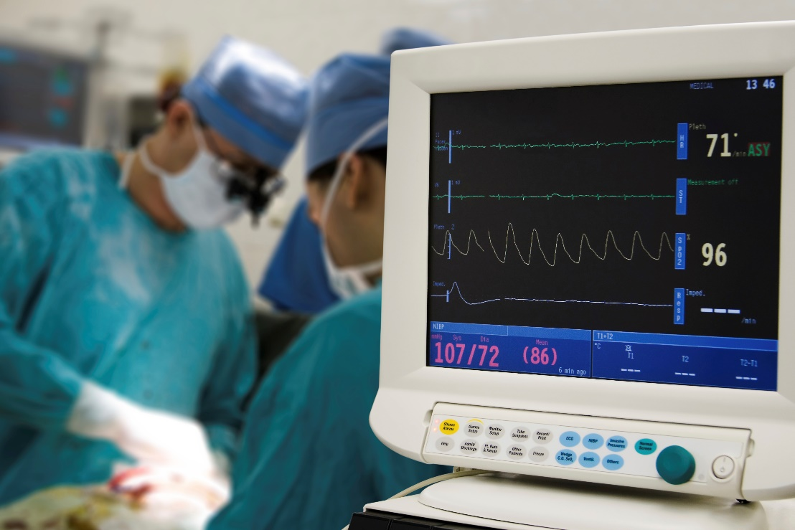
OR in detail – Healthcare
Moving people through waiting lists as quickly as possible
Using hospital resources as efficiently as possible
Increasing the number of transplant operations
Notes:
Please feel free to paraphrase the below:
Some hospitals have dedicated OR teams to help with resource allocation – especially if they have multiple specialities. The OR staff allocate patients, equipment and surgical teams to operating theatres based on the urgency and specific requirements of each patient – some operations need specialist equipment and others do not and it’s not very efficient to have a ‘general’ patient in a ‘specialist’ surgery.
The OR team have to set a schedule, which is made complicated by the fact that how long an operation takes can be hard to predict and an emergency patient might need immediate attention and throw off the rest of the rota! OR researchers designed an algorithm to optimise kidney transplant surgery – imagine somebody needs a kidney transplant and their family member is willing to be a donor, but is incompatible. The algorithm identifies patients in this situation and matches them up so they can swap donors, and both patients receive the kidney that they need.
The surgery has to take place simultaneously to prevent anybody from backing out at the last minute, so the algorithm also has to take into account the nearest hospital with enough resources (theatres and surgical teams) to carry out the transplant when matching patients.

Slide 19
When is OR used?
When a decision is complex or it’s unclear what the main problem is
When you don’t know how well things are working or think they could work better
Notes:
Decision-making and problem-solving in business can be complicated and messy.
It may not be clear what the main problem is, what the outcome of different actions may be or how well things are currently working, and there may be lots of different factors to consider.
For example, if things don’t go well when businesses make big changes, they might upset customers, slow down production or create a need for extra staff training. Any of these could have a negative impact on the business. OR can help to reduce the chances of this happening.

Slide 20
What OR techniques are used?
Simulation is used to try different solutions and answers the “What if…?” question.
Optimisation uses problem solving to achieve the best outcome.
Notes:
Some commonly used OR techniques include:
Optimisation – depending on what variable is most important (manufacturing something quickly, or maximising profit?), optimisation will find the best use of limited resources.
Simulation – this modelling tool is fantastic when there are a lot of different ways to solve a problem as you can try lots of different solutions until you find the best one. It also allows something to be tested in a safe way, for example, organisations like the NHS have to be careful when making changes as lives could be at risk!
Also many more techniques – including algorithms!

Slide 21
Where can OR take you?
Notes:
Non-exhaustive list of businesses that use OR. Please note they are not endorsed by The OR Society but are designed to show the variety of careers in OR. Feel free to use your own examples if relevant.

Slide 22
Interested?
Next steps:
Maths GCSE and A Level
Further Maths and Computer Science are highly beneficial
Obtain a good classification in a STEM degree
A masters degree in OR is often desirable, although not always essential
Notes:
Depending on the age of the audience this may or may not be relevant.
Not many universities offer OR degrees, although some offer maths and OR degrees or similar. OR is often a module in a maths or business studies degree and can be hard to find on its own.
STEM degrees (science, technology, engineering and maths) show a skill set and analytical way of thinking that is often beneficial to people working in OR and are a good alternative to an (often elusive) OR degree.

Slide 23
Find out more
www.theorsociety.com
@ORinEducation
Notes:
Careers information, OR news and information on free student membership (available for people aged 16+) can be found on our website.

